Slide 1
Better Together: Text + Context
Kenneth Church

Slide 2
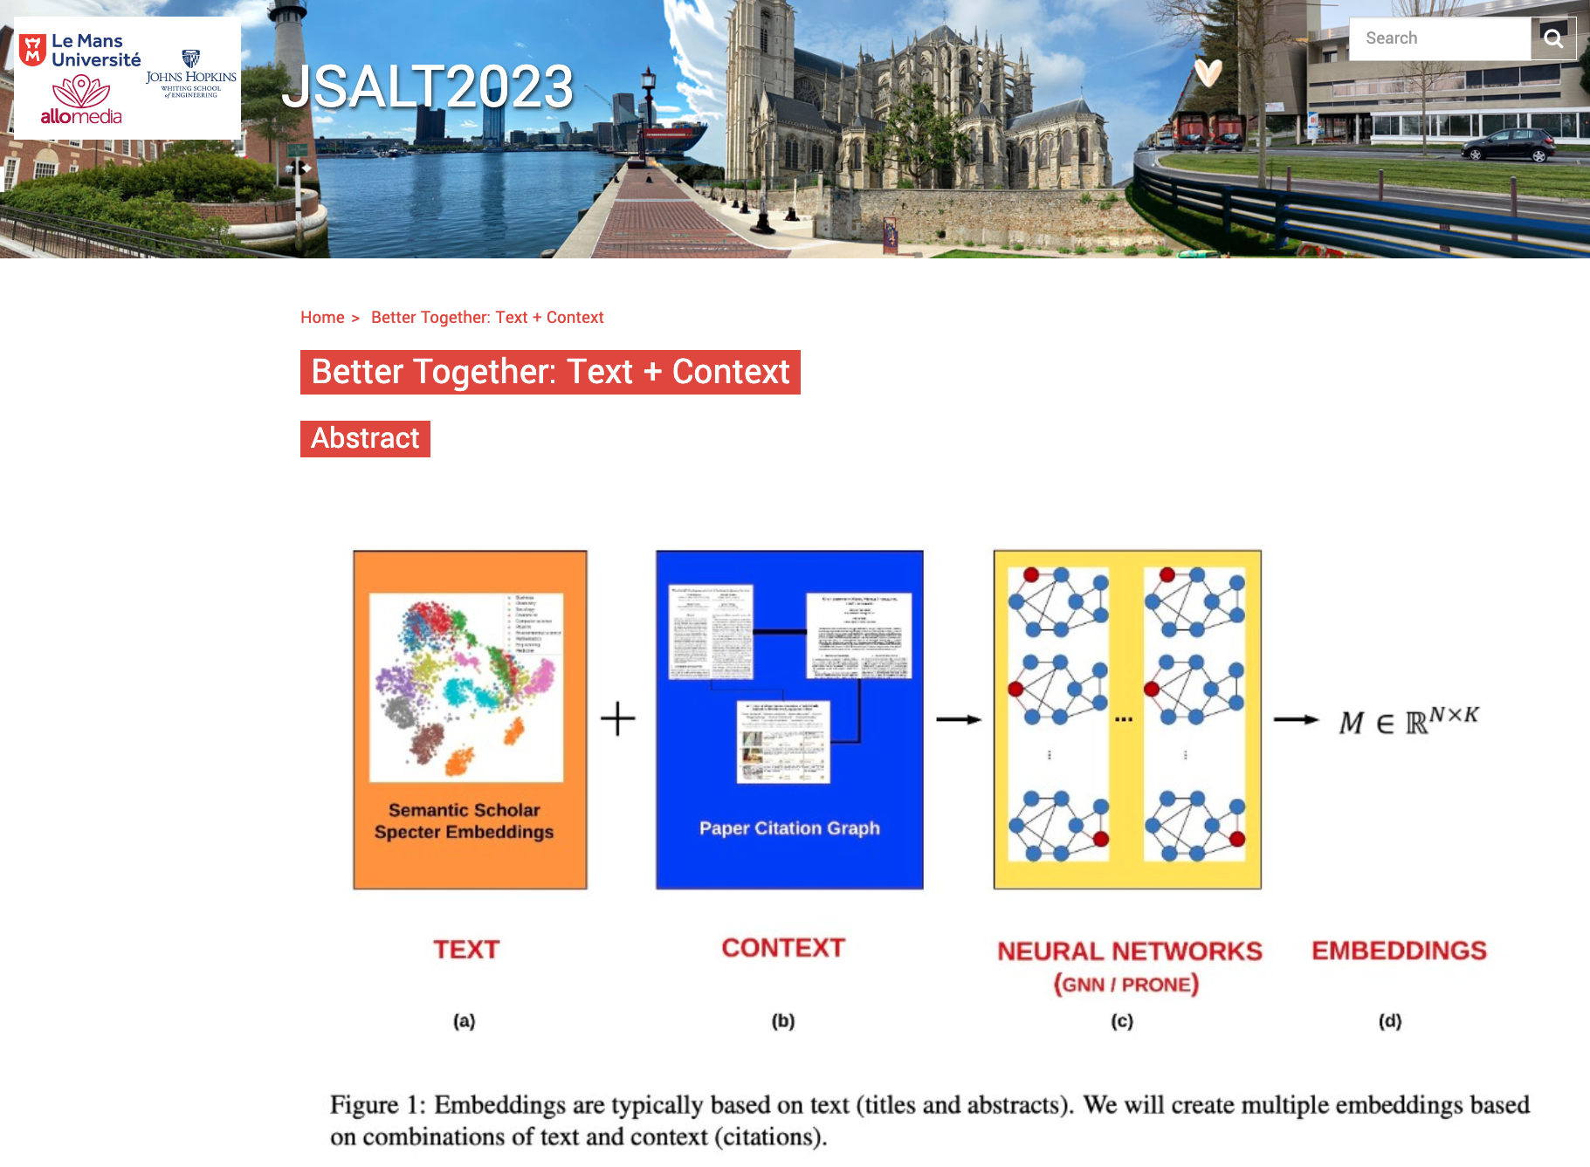
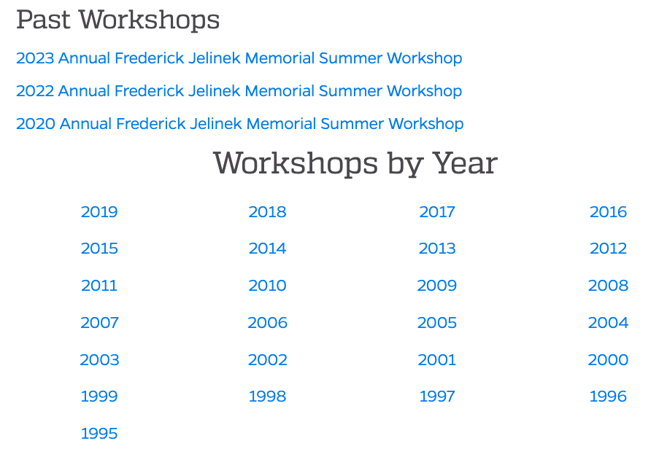
JSALT is a go! 2023 Jelinek Summer Workshop on Speech and Language Technology https://www.clsp.jhu.edu/2023-jelinek-summer-workshop/
Six weeks in France
Collaboration
Northeastern
Allen AI (Semantic Scholar)
UMass Amherst
https://www.clsp.jhu.edu/workshops/

Slide 3
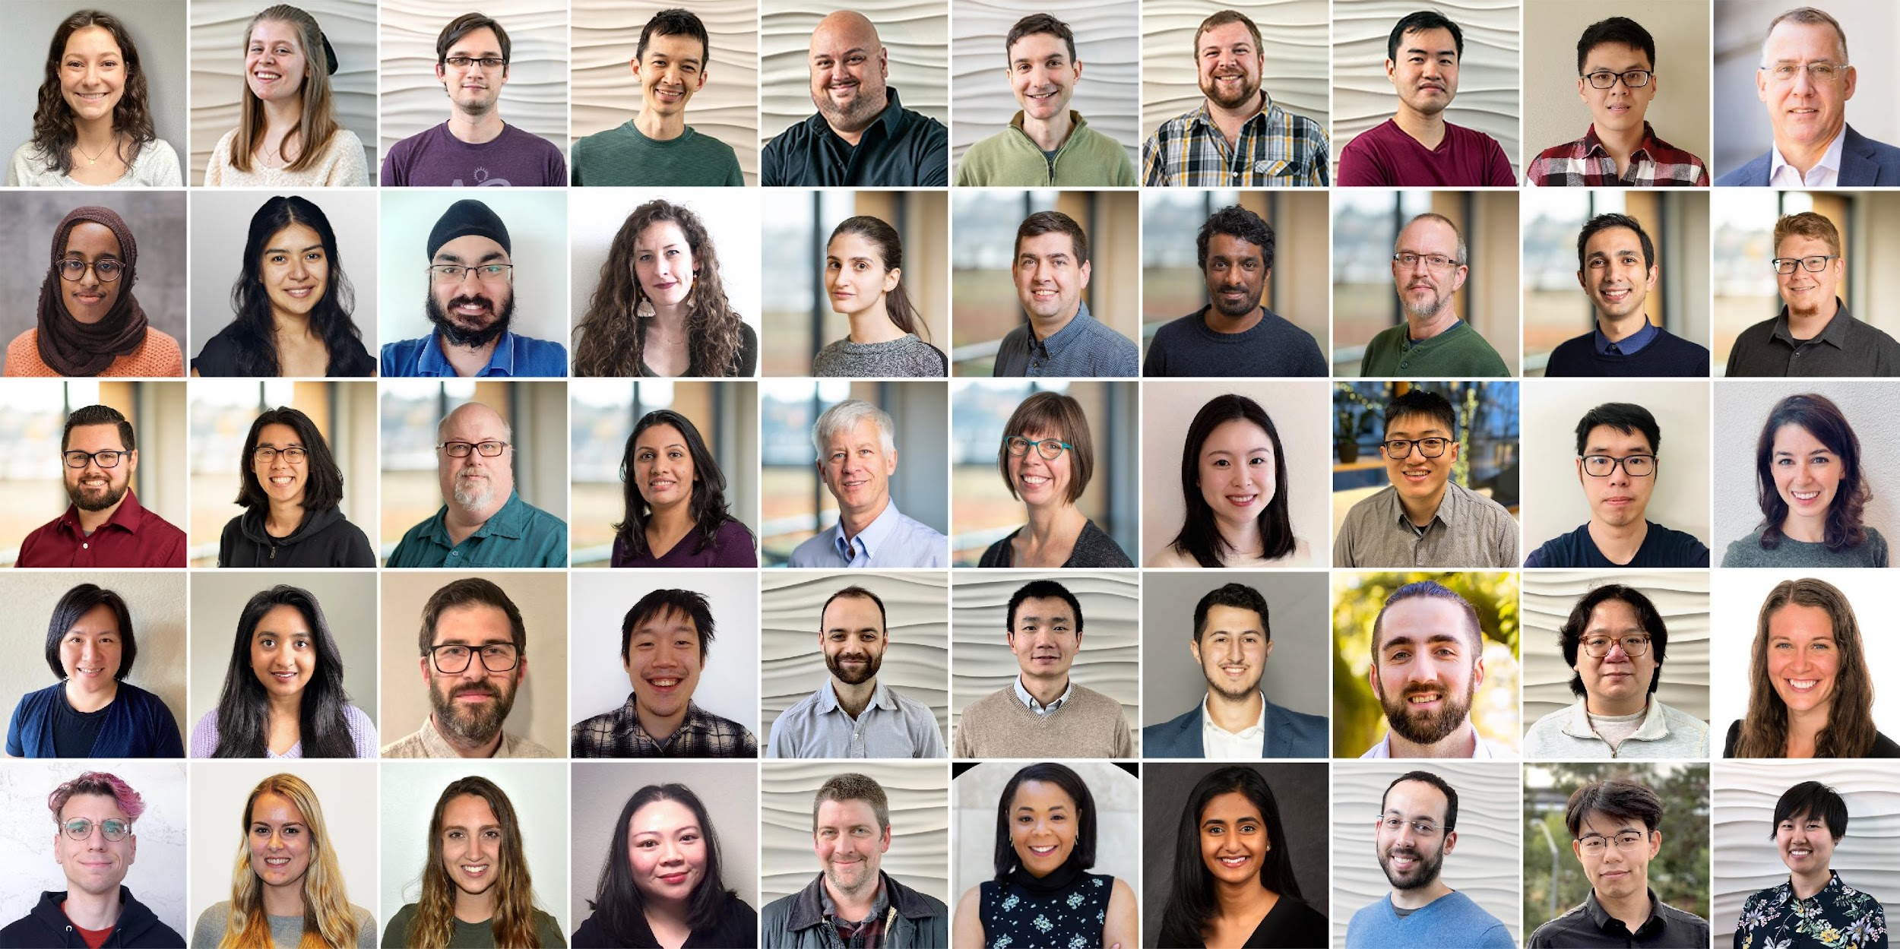
Semantic Scholar: Significant Effort (source: Dan Weld)
SCALE | SCALE
 | Source | Papers (millions)
1 | CorpusId | 207.80
2 | MAG (Microsoft Academic Graph) | 182.18
3 | DOI | 113.54
4 | PubMed | 35.03
5 | DBLP | 6.06
6 | PubMedCentral | 4.86
7 | ArXiv | 2.15
8 | ACL | 0.08
50 person team; 7 year project
207M+ papers; 2B Citations
8M+ monthly active users

Slide 4
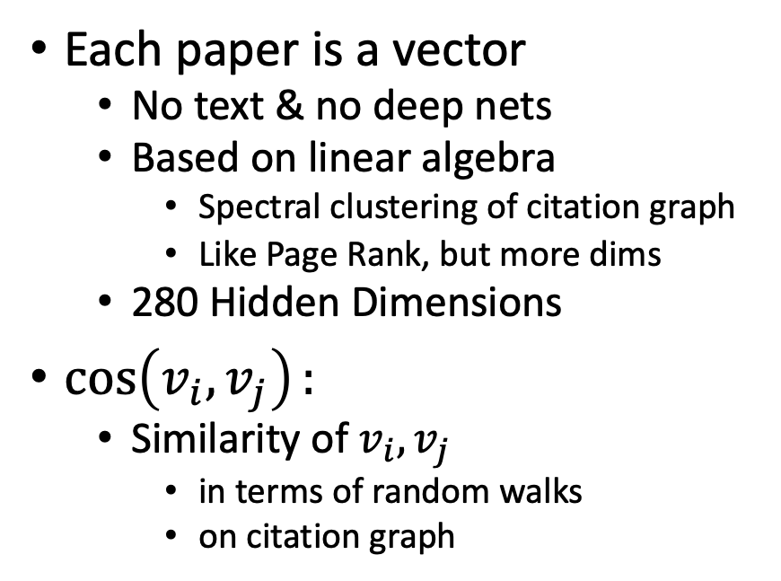
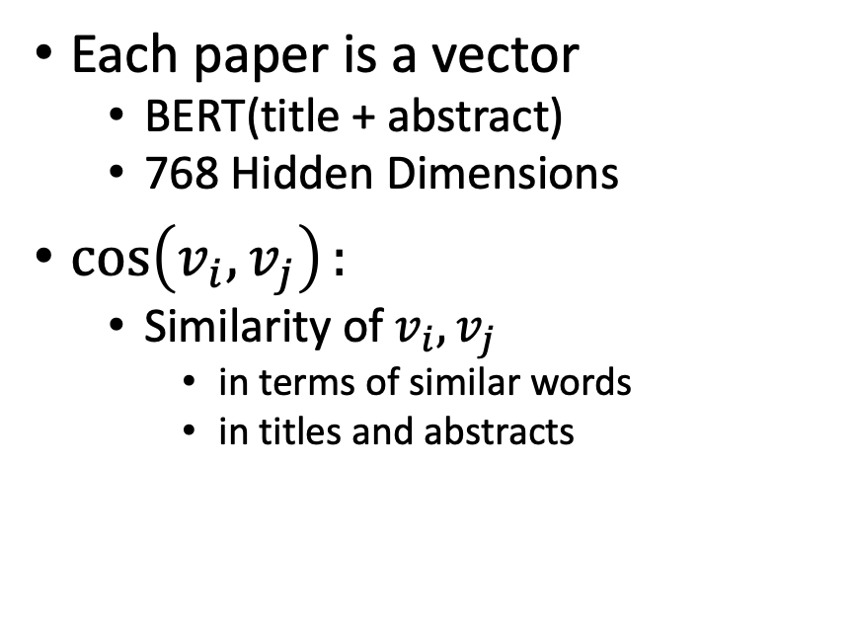
Better Together: Text (Abstracts) + Context (Citations)
Node-based Methods (Text)
Edge-based Methods (Citations)
Each paper is a vector
BERT(title + abstract)
768 Hidden Dimensions
$\cos\left(v_{i},v_{j}\right):$
Similarity of $v_{i},v_{j}$
in terms of similar words
in titles and abstracts
Each paper is a vector
No text & no deep nets
Based on linear algebra
Spectral clustering of citation graph
Like Page Rank, but more dims
280 Hidden Dimensions
$\cos\left(v_{i},v_{j}\right):$
Similarity of $v_{i},v_{j}$
in terms of random walks
on citation graph

Slide 5
Recommendation Use Cases
For readers:
What should I read?
For authors:
What should I cite?
For conference organizers:
Who should review what?
Finding experts:
Who knows? (Streeter & Lochbaum, 1998)

Slide 6
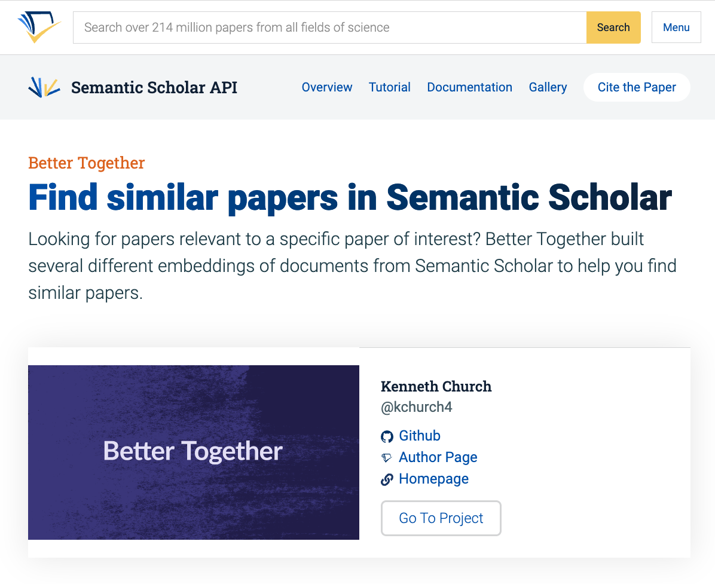
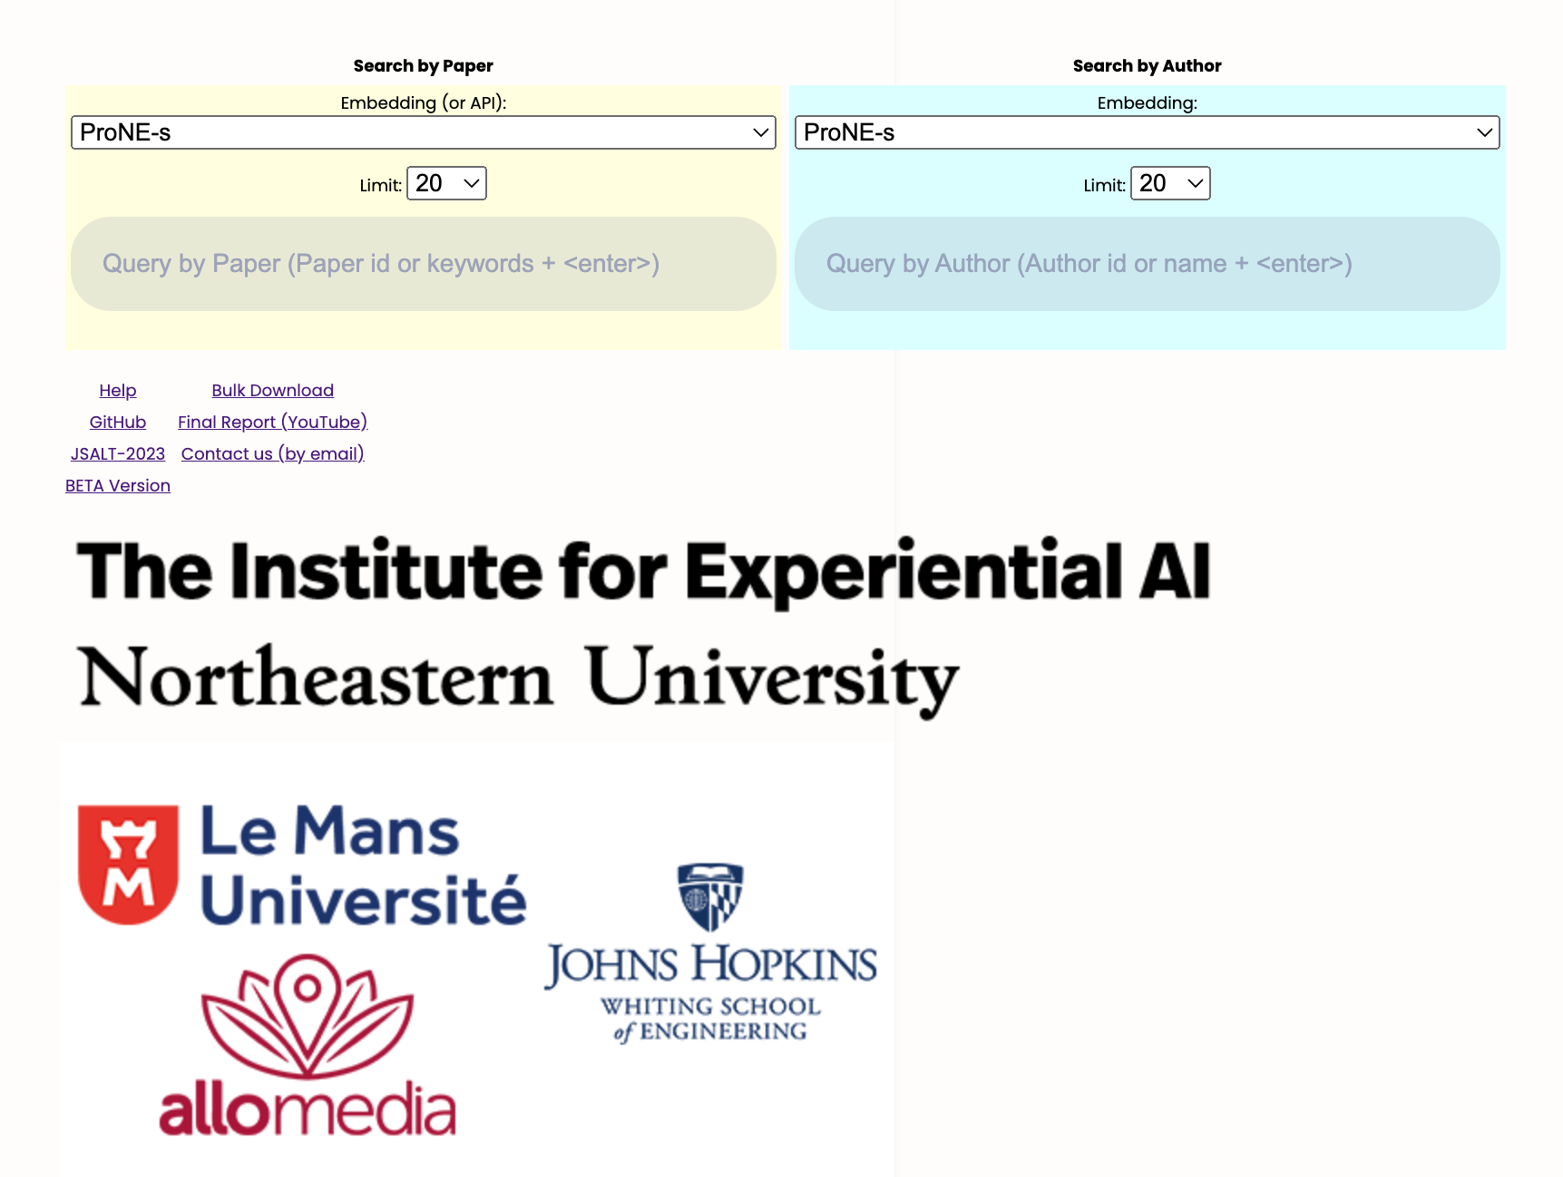
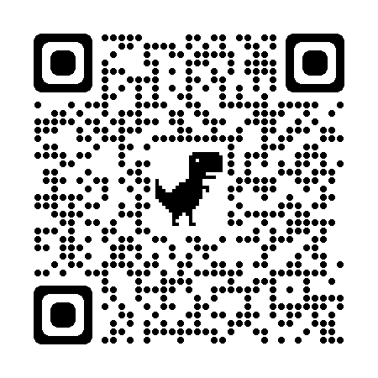
https://www.semanticscholar.org/api-gallery/better-together

Slide 7
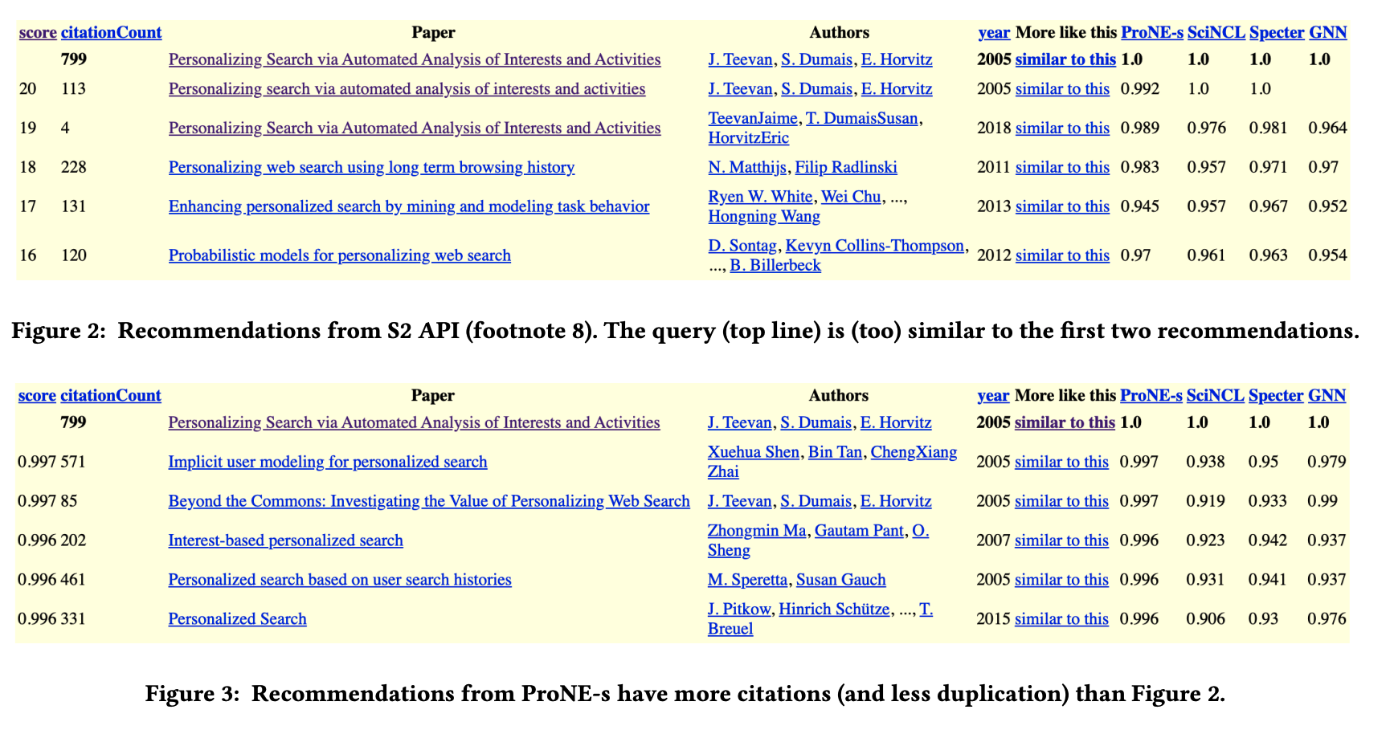

Slide 8
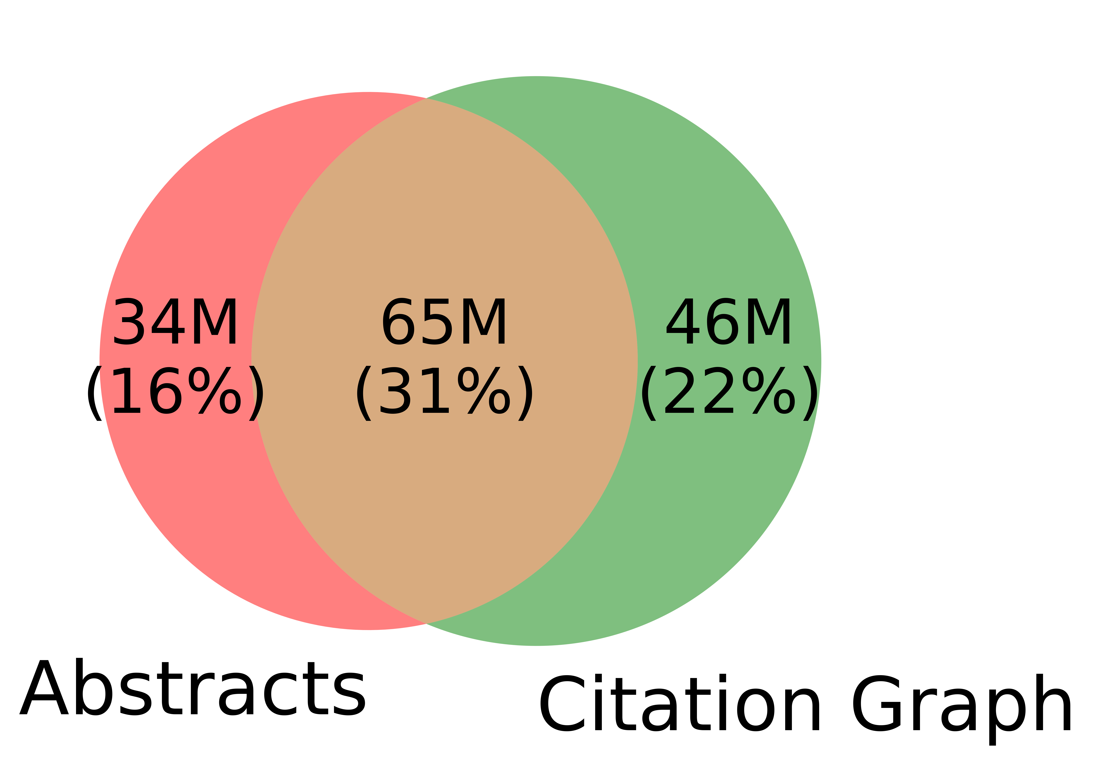
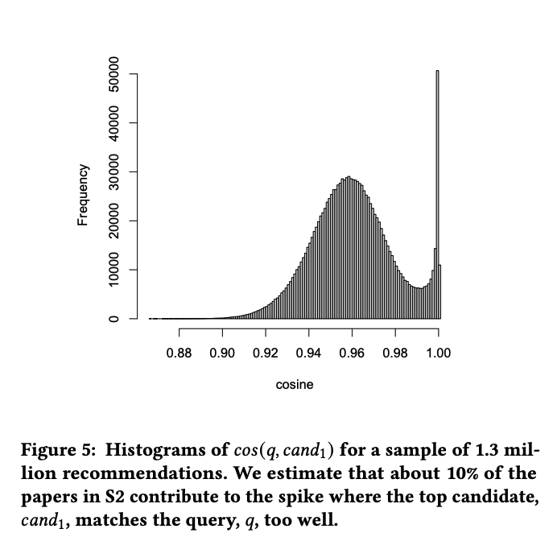
Many Corner Cases
Other
31%
Redundancy
Challenges for text-based methods
Duplicates
Missing/Bad Values
Non-English
Citation-based methods do not run into these corner cases, but
Missing/Bad Values
Reality: Missing Values
GNNs (graph neural nets) assume
all papers have abstracts & links

Slide 10
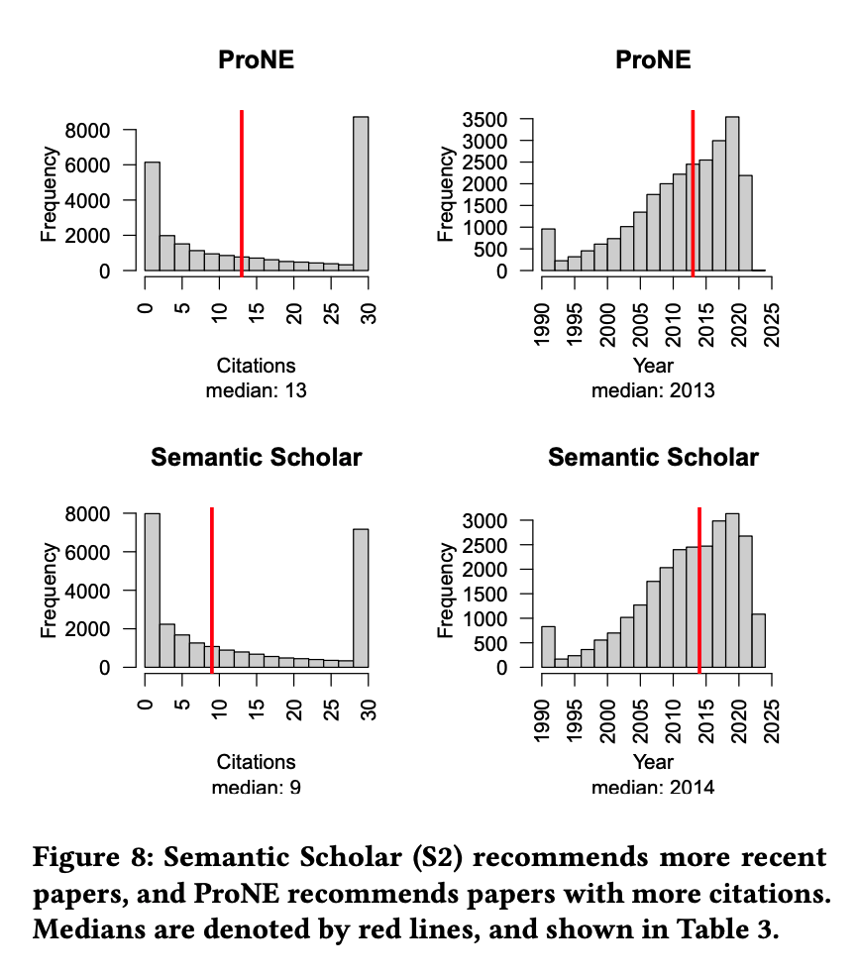
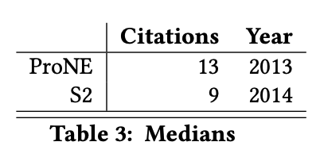
Evaluation: Better Together
Evaluation sections usually show proposed method is better than alternatives,
but we want to show methods
complement one another
Users are encouraged
to explore options
to find methods
that work well for their use case.
+
+

Slide 11
Some more practical use cases
Who is who?
Many authors have similar names such as David Madigan
Easier to match on papers than names
WSDM-2024
Input papers at conference (queries)
Output recommendations for each query
Chatbots: Compare & contrast queries with recommendations

Slide 12
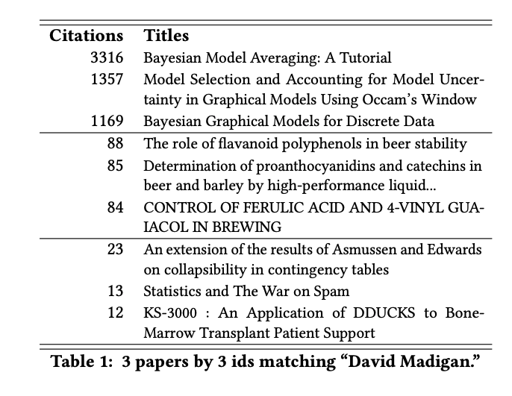
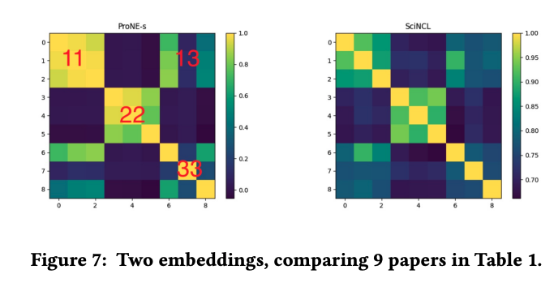
Who is Who? Easier to match on papers than names

Slide 13
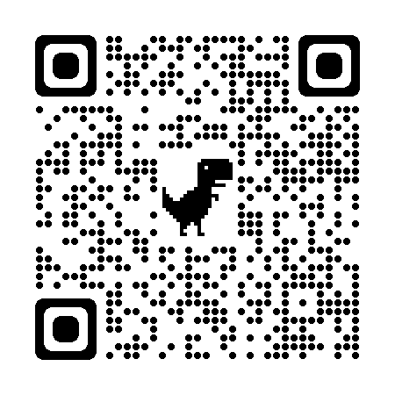
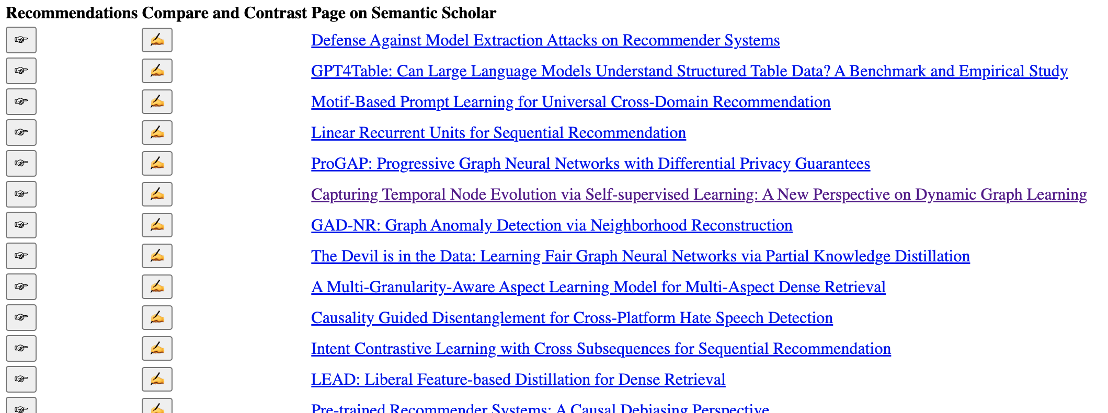
WSDM-2024 Papers on arXiv

Slide 14
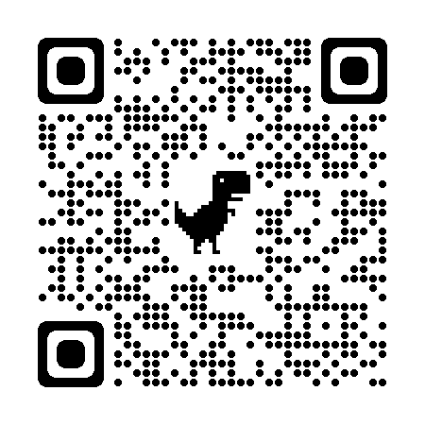
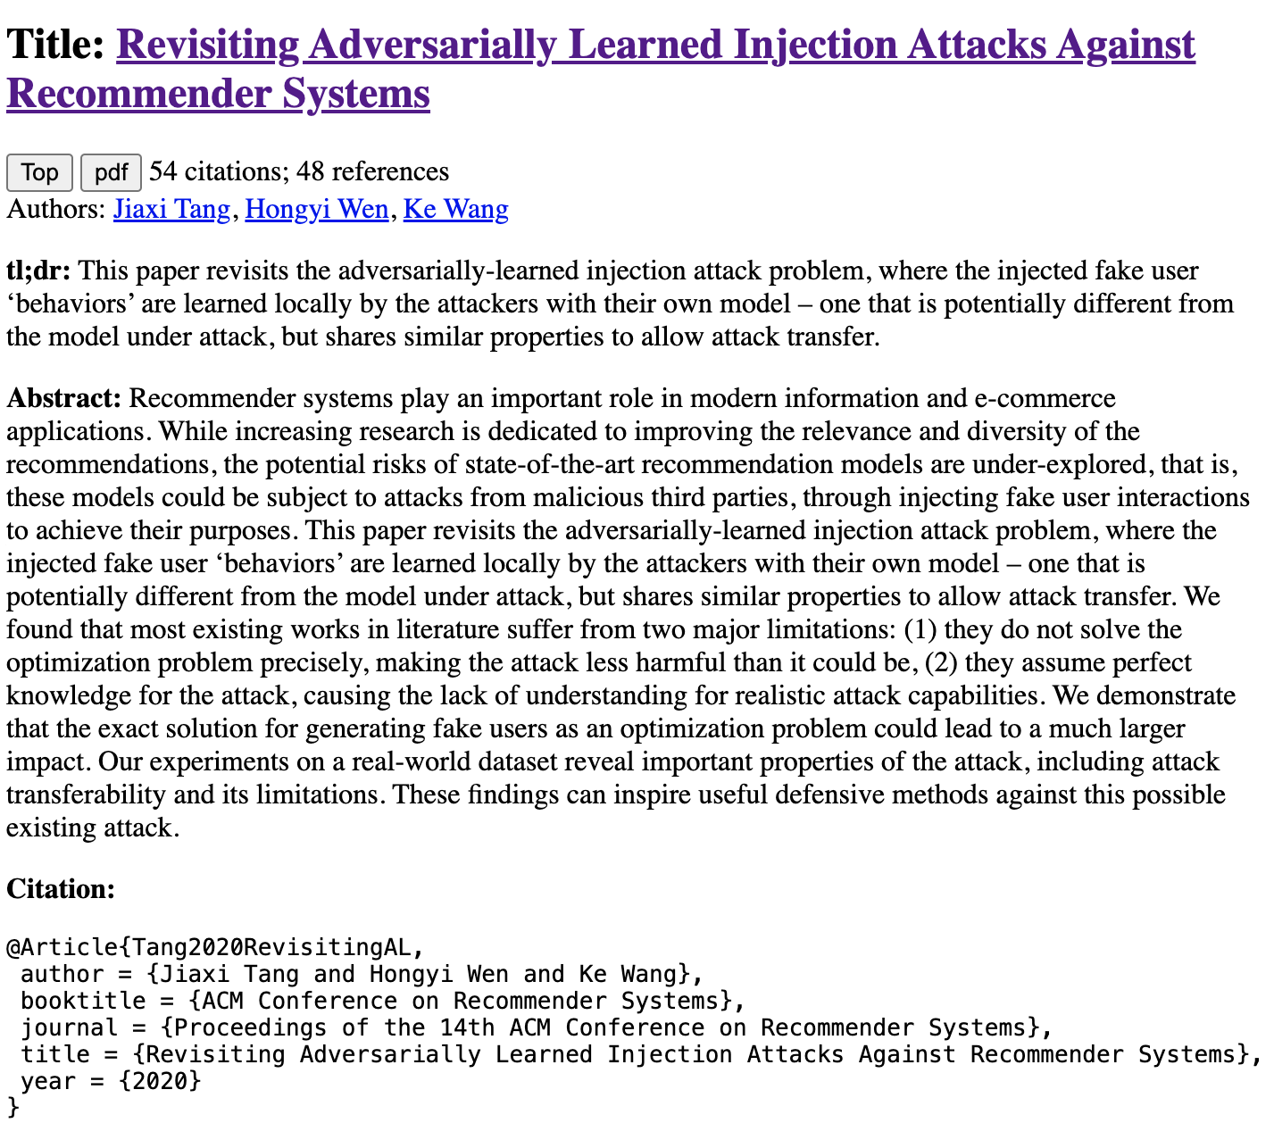
Compare and Contrast
Input: query + candidate
Use prompts (chatbots)
Summary of candidate
Similarities of query & candidate
Differences of query & candidate

Slide 15
Output from Chatbot
Similarities
Differences
As an Assistant, I can tell you that both "Revisiting Adversarially Learned Injection Attacks Against Recommender Systems" and "Defense Against Model Extraction Attacks on Recommender Systems" focus on security aspects of recommender systems.
The first paper explores injection attacks where the attacker manipulates the recommendation model by injecting malicious data,
while the second paper deals with defending against model extraction attacks aimed at extracting sensitive information from the recommender system.
Both papers highlight the importance of addressing security vulnerabilities in recommender systems to protect user data and maintain the integrity of the recommendation models.
"Revisiting Adversarially Learned Injection Attacks Against Recommender Systems" focuses on exploring adversarially learned injection attacks against recommender systems,
where the attacker has knowledge about the dataset used to train the target recommendation model.
On the other hand, "Defense Against Model Extraction Attacks on Recommender Systems" focuses on strategies to defend against model extraction attacks,
where attackers try to extract the architecture or parameters of a recommender system.
The former paper deals with adversarial attacks, while the latter focuses on defense mechanisms against a different type of attack.

Slide 16
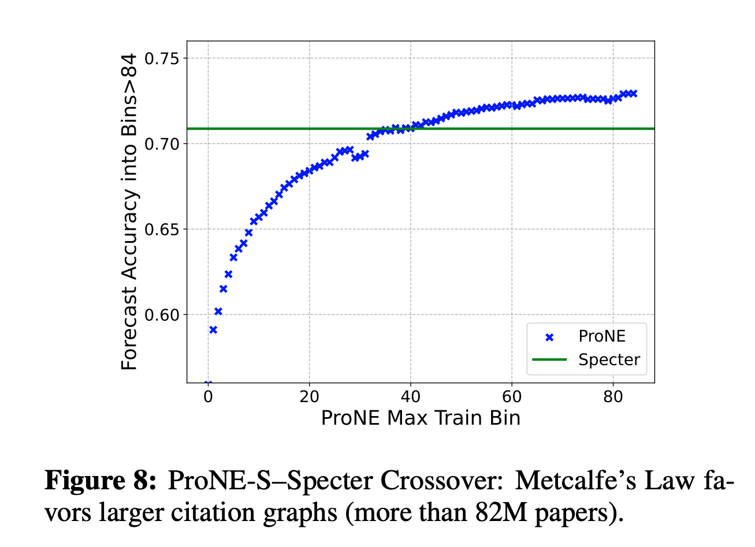
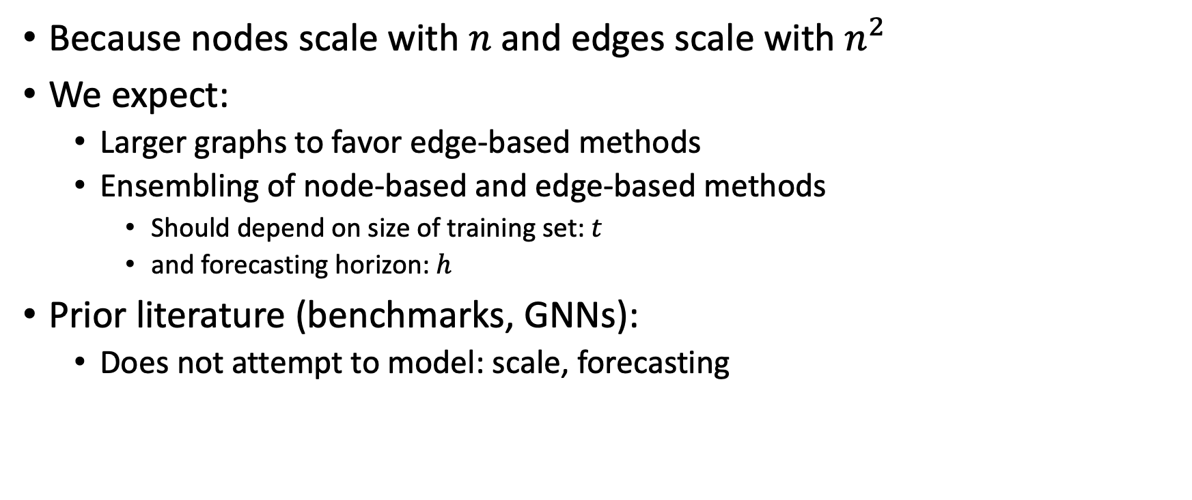
Network Effects: Conjectures
Because nodes scale with $n$and edges scale with $n^{2}$
We expect:
Larger graphs to favor edge-based methods
Ensembling of node-based and edge-based methods
Should depend on size of training set: $t$
and forecasting horizon: $h$
Prior literature (benchmarks, GNNs):
Does not attempt to model: scale, forecasting

Slide 17
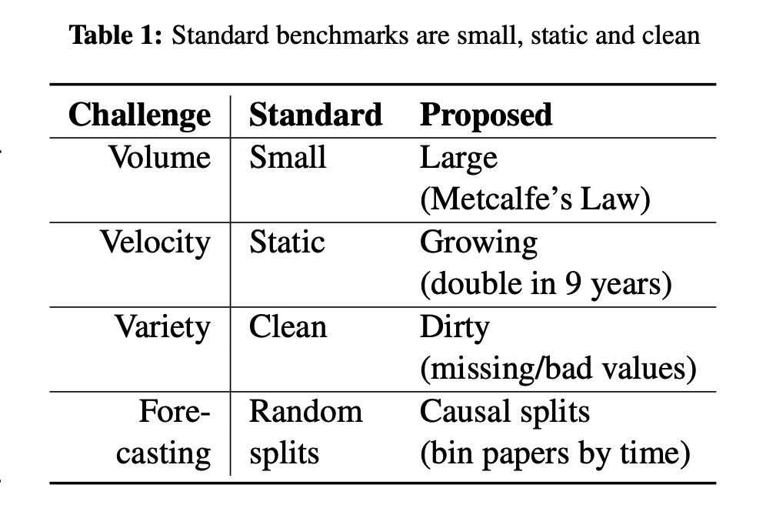

Slide 18
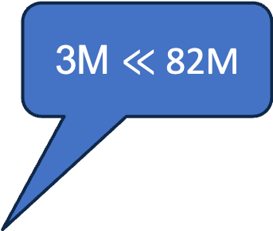
3M $≪$ 82M
Benchmark | #N | #E | Hidden Dimensions (node features)
ogbl-citation2 | 3M | 31M | 128 (eg. word2vec)
Semantic Scholar | 200M | 2B | 768 (eg. Bert)
Notes:
Graph showing growth

Slide 19
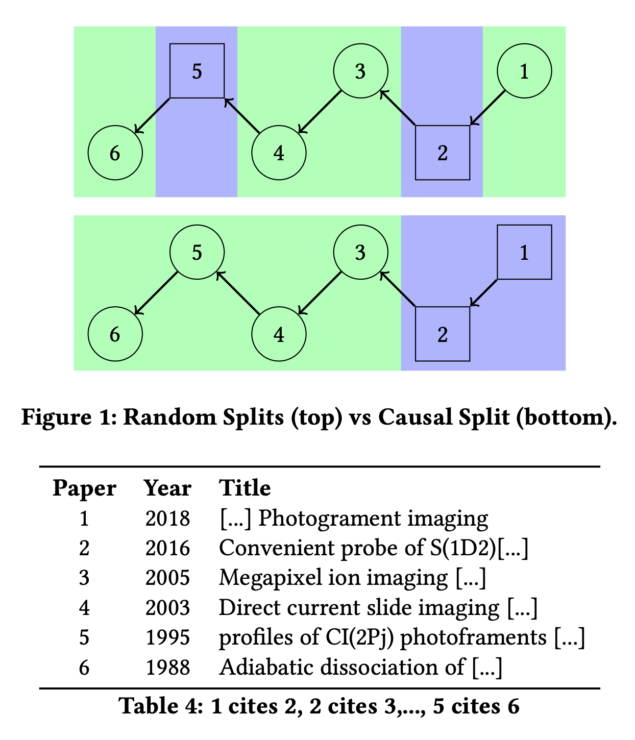
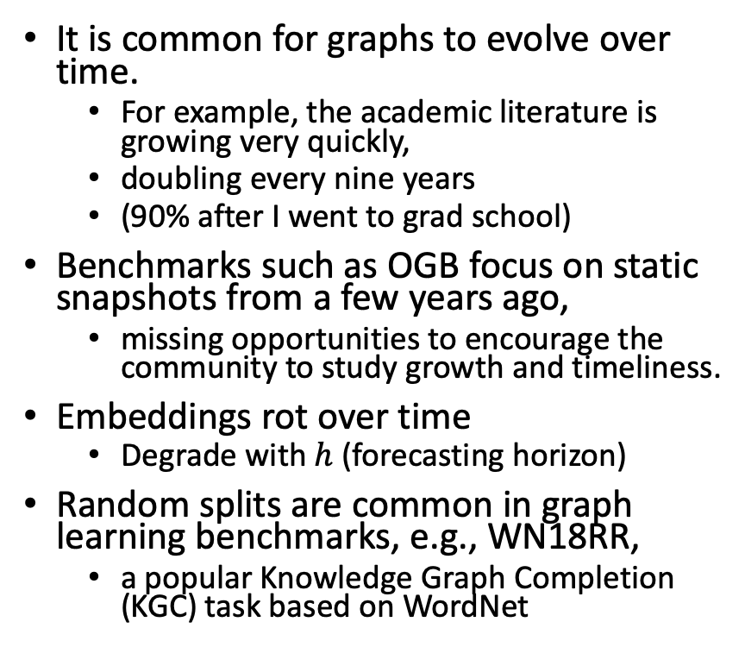
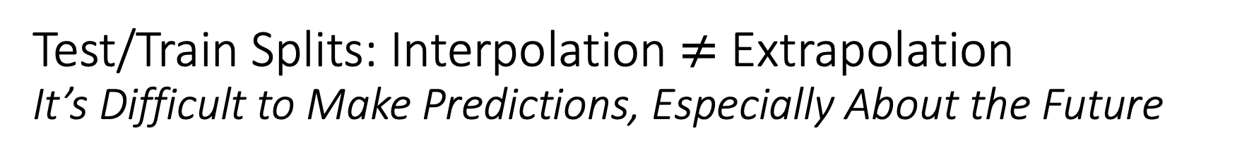
Test/Train Splits: Interpolation $≠$ Extrapolation It’s Difficult to Make Predictions, Especially About the Future
It is common for graphs to evolve over time.
For example, the academic literature is growing very quickly,
doubling every nine years
(90% after I went to grad school)
Benchmarks such as OGB focus on static snapshots from a few years ago,
missing opportunities to encourage the community to study growth and timeliness.
Embeddings rot over time
Degrade with $h$ (forecasting horizon)
Random splits are common in graph learning benchmarks, e.g., WN18RR,
a popular Knowledge Graph Completion (KGC) task based on WordNet

Slide 20
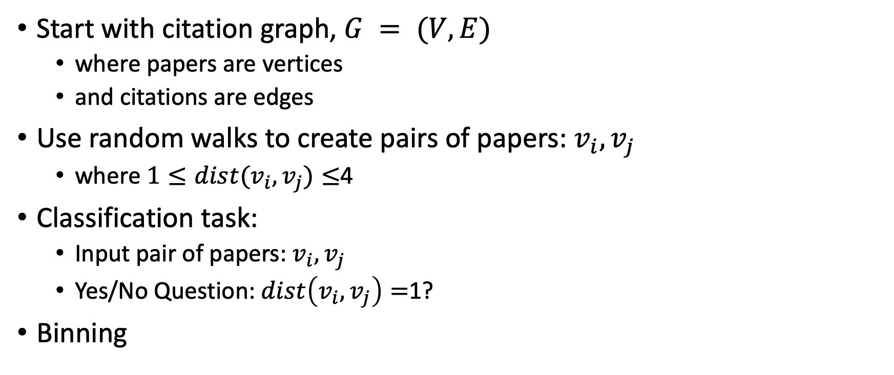
Link Prediction Task: Intrinsic Evaluation
Start with citation graph, $G = (V, E)$
where papers are vertices
and citations are edges
Use random walks to create pairs of papers: $v_{i},v_{j}$
where $1≤dist(v_{i},v_{j})≤$4
Classification task:
Input pair of papers: $v_{i},v_{j}$
Yes/No Question: $dist\left(v_{i},v_{j}\right)=$1?
Binning

Slide 21
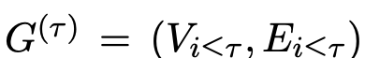
Binning It’s Difficult to Make Predictions, Especially About the Future
Split 200M papers into 100 bins
Rank papers by publication date
First 2M papers → bin0
Next 2M papers → bin1
Construct 100 graphs:
that include papers (vertices) in the current bin or previous bins
and citations (edges) from these papers to papers in the current bin or previous bins
Construct 100 ProNE-s models,
One for each graph

Slide 22
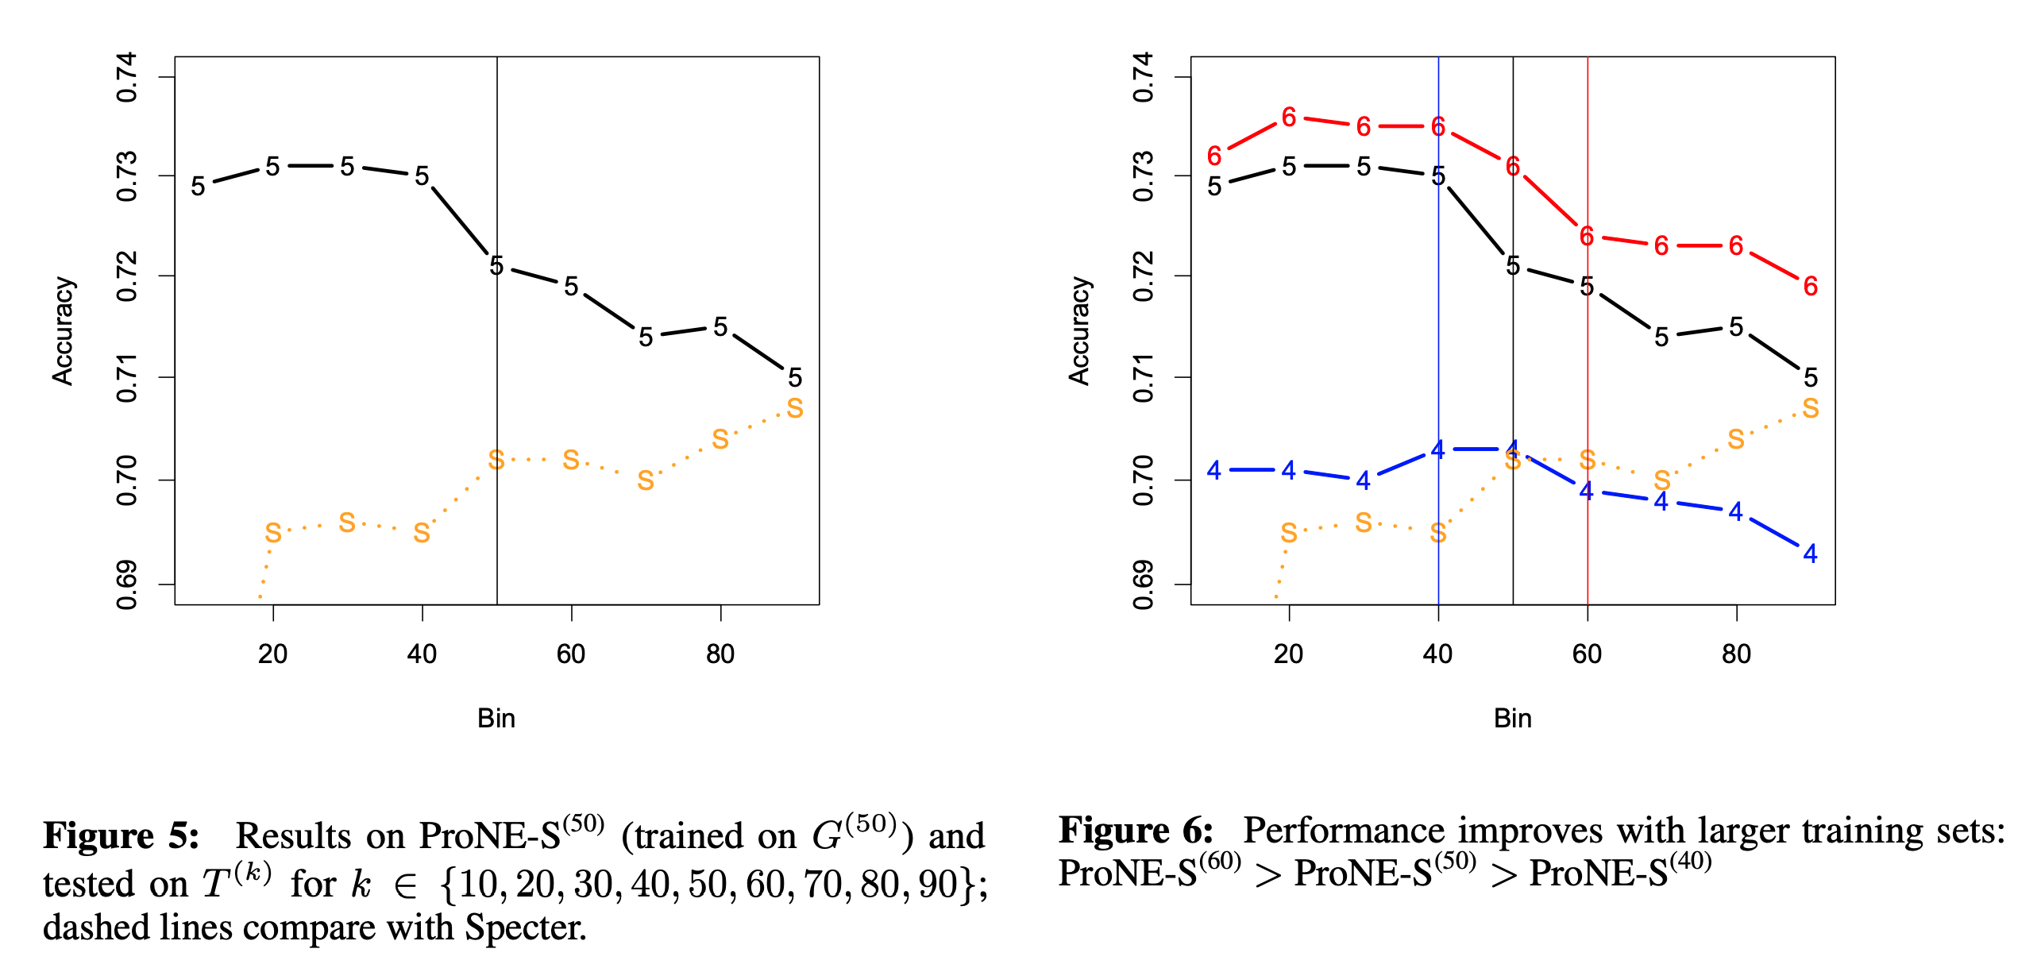
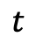
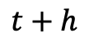
$$t$$
$$t+h$$

Slide 23
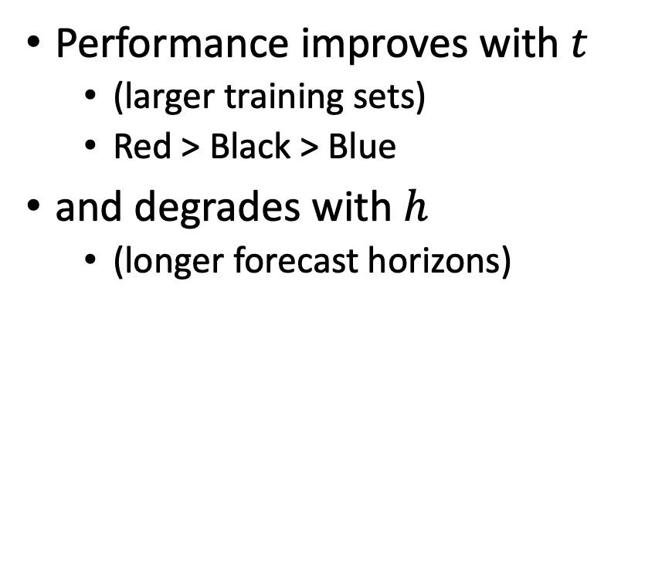
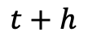
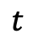
Take-Aways
$$t$$
$$t+h$$
Performance improves with $t$
(larger training sets)
Red > Black > Blue
and degrades with $h$
(longer forecast horizons)

Slide 24
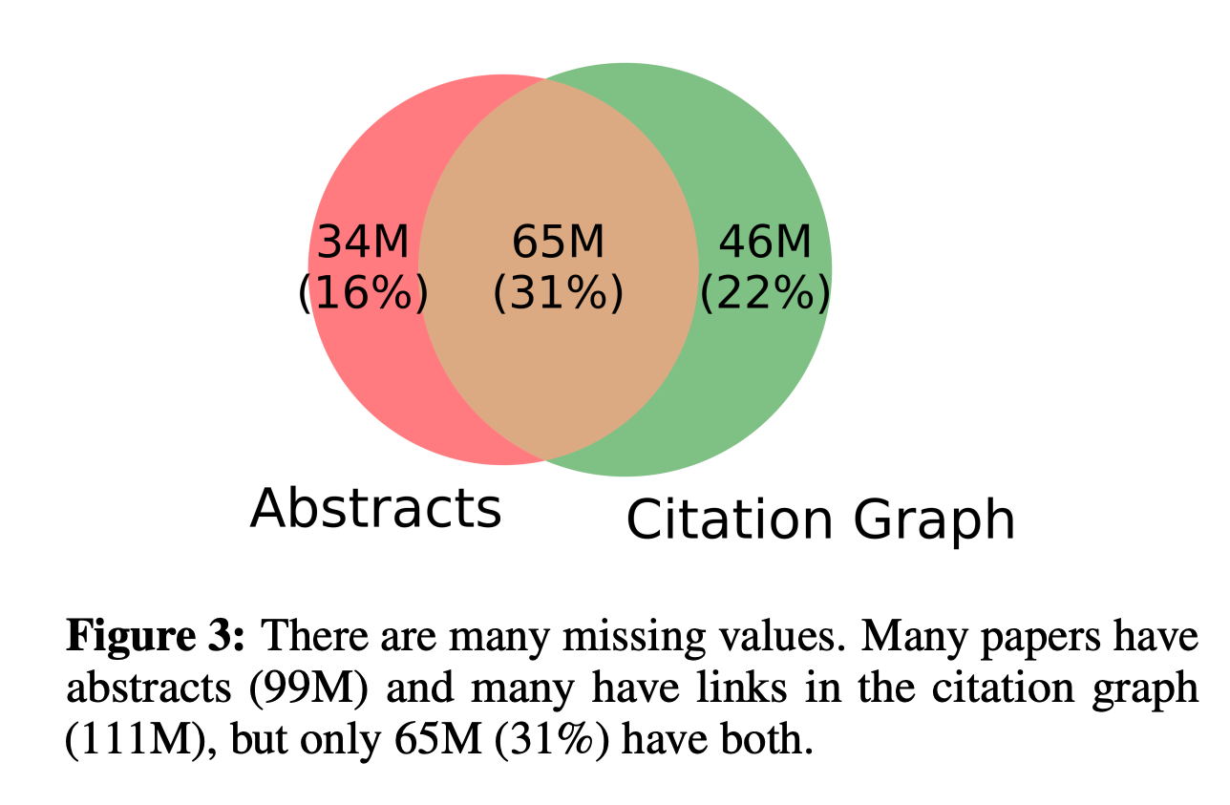
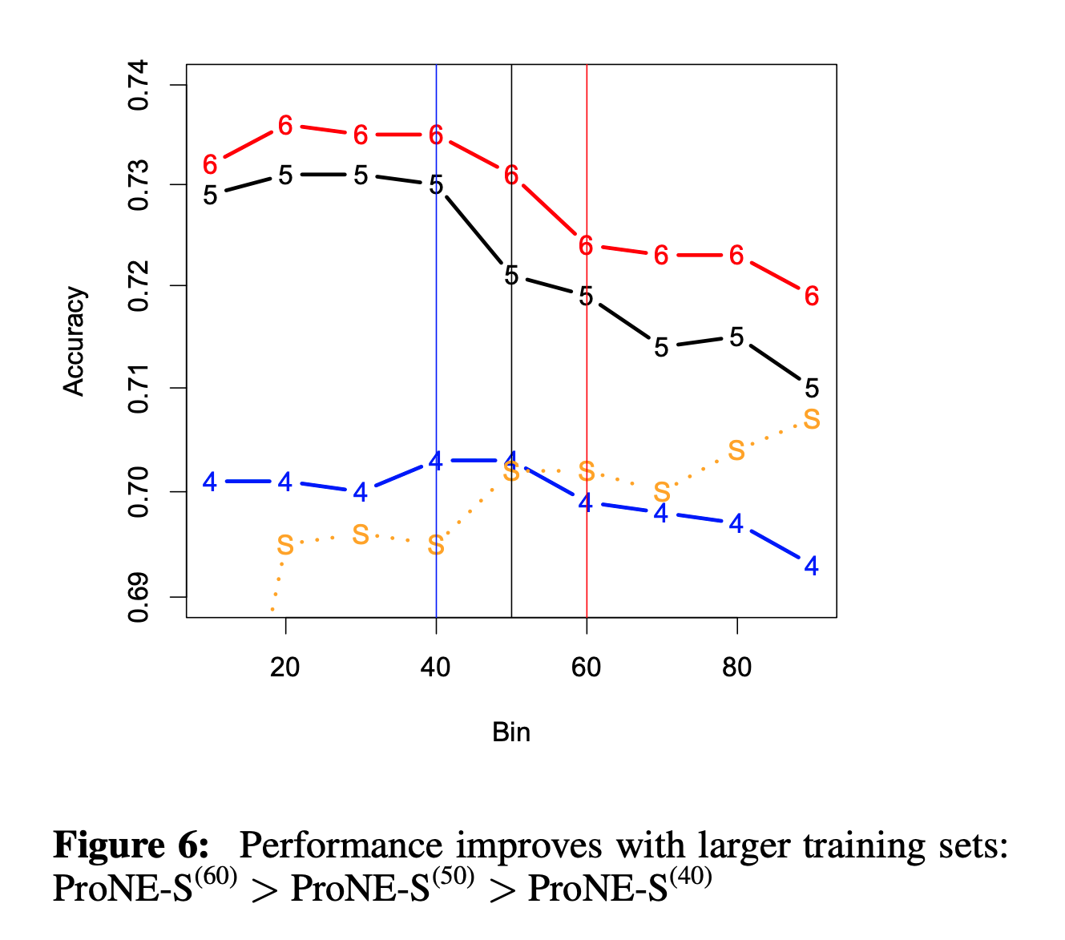
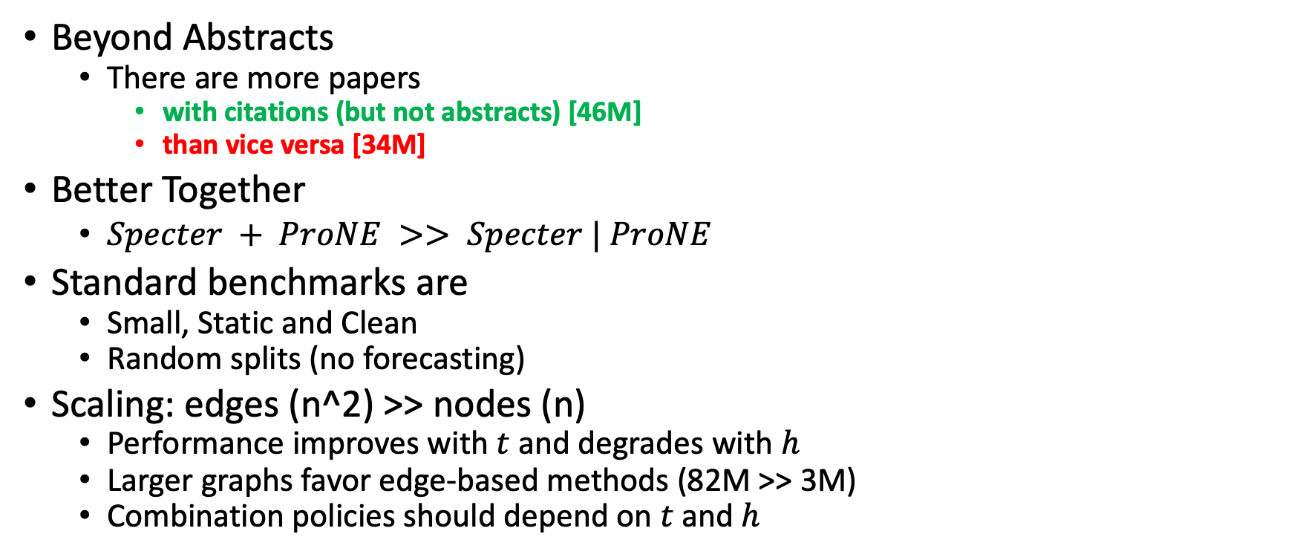
Conclusions
Beyond Abstracts
There are more papers
with citations (but not abstracts) [46M]
than vice versa [34M]
Better Together
$Specter + ProNE >> Specter | ProNE$
Standard benchmarks are
Small, Static and Clean
Random splits (no forecasting)
Scaling: edges (n^2) >> nodes (n)
Performance improves with $t$ and degrades with $h$
Larger graphs favor edge-based methods (82M >> 3M)
Combination policies should depend on $t$and $h$

Slide 25
Back-up

Slide 26
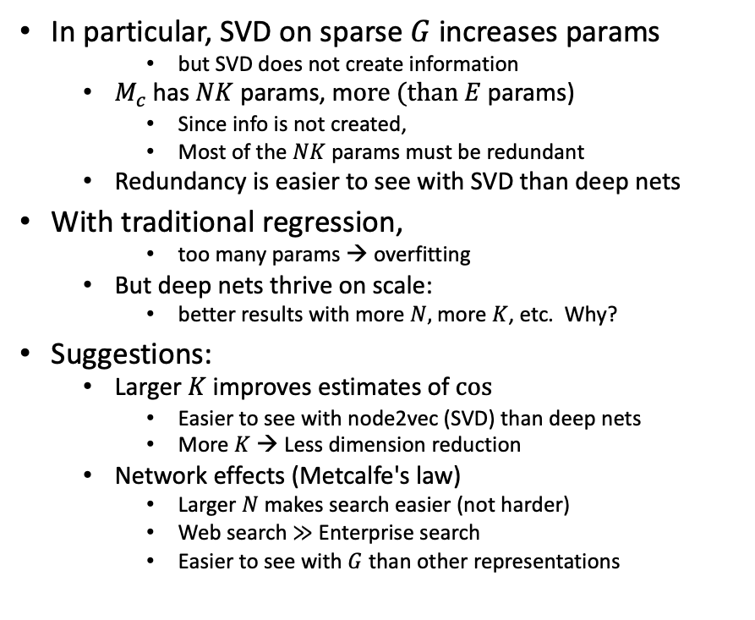
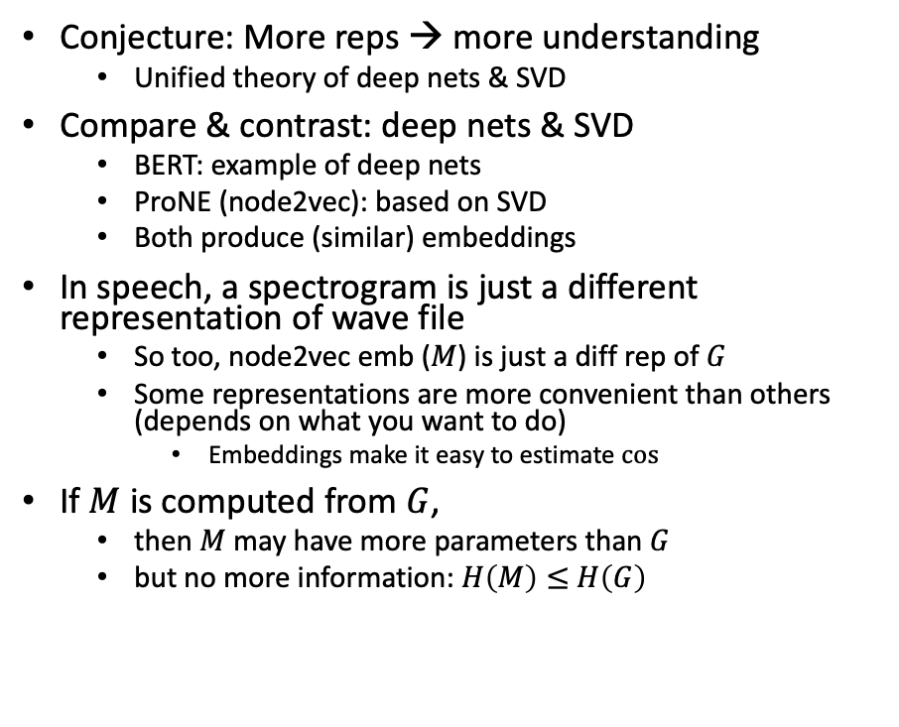
Bigger Stretch: Theoretical combinations of deep nets & SVD
Conjecture: More reps → more understanding
Unified theory of deep nets & SVD
Compare & contrast: deep nets & SVD
BERT: example of deep nets
ProNE (node2vec): based on SVD
Both produce (similar) embeddings
In speech, a spectrogram is just a different representation of wave file
So too, node2vec emb ($M$) is just a diff rep of $G$
Some representations are more convenient than others (depends on what you want to do)
Embeddings make it easy to estimate $cos⁡⁡$
If $M$ is computed from $G$,
then $M$ may have more parameters than $G$
but no more information: $H\left(M\right)≤$ $H\left(G\right)$
In particular, SVD on sparse $G$increases params
but SVD does not create information
$M_{c}$has $NK$ params, m$ore (than E$params)
Since info is not created,
Most of the $NK$ params must be redundant
Redundancy is easier to see with SVD than deep nets
With traditional regression,
too many params → overfitting
But deep nets thrive on scale:
better results with more $N,$ more $K$, etc. Why?
Suggestions:
Larger $K$ improves estimates of $cos⁡$
Easier to see with node2vec (SVD) than deep nets
More $K$ → Less dimension reduction
Network effects (Metcalfe's law)
Larger $N$ makes search easier (not harder)
Web search $≫$ Enterprise search
Easier to see with $G$ than other representations

